Slide 1
Robotics term project proposal
: Team name : Kughui I made
202334418_KugHui Geun
202334540_Jeong InGyo
202334556_Choo HoSeong

Slide 2
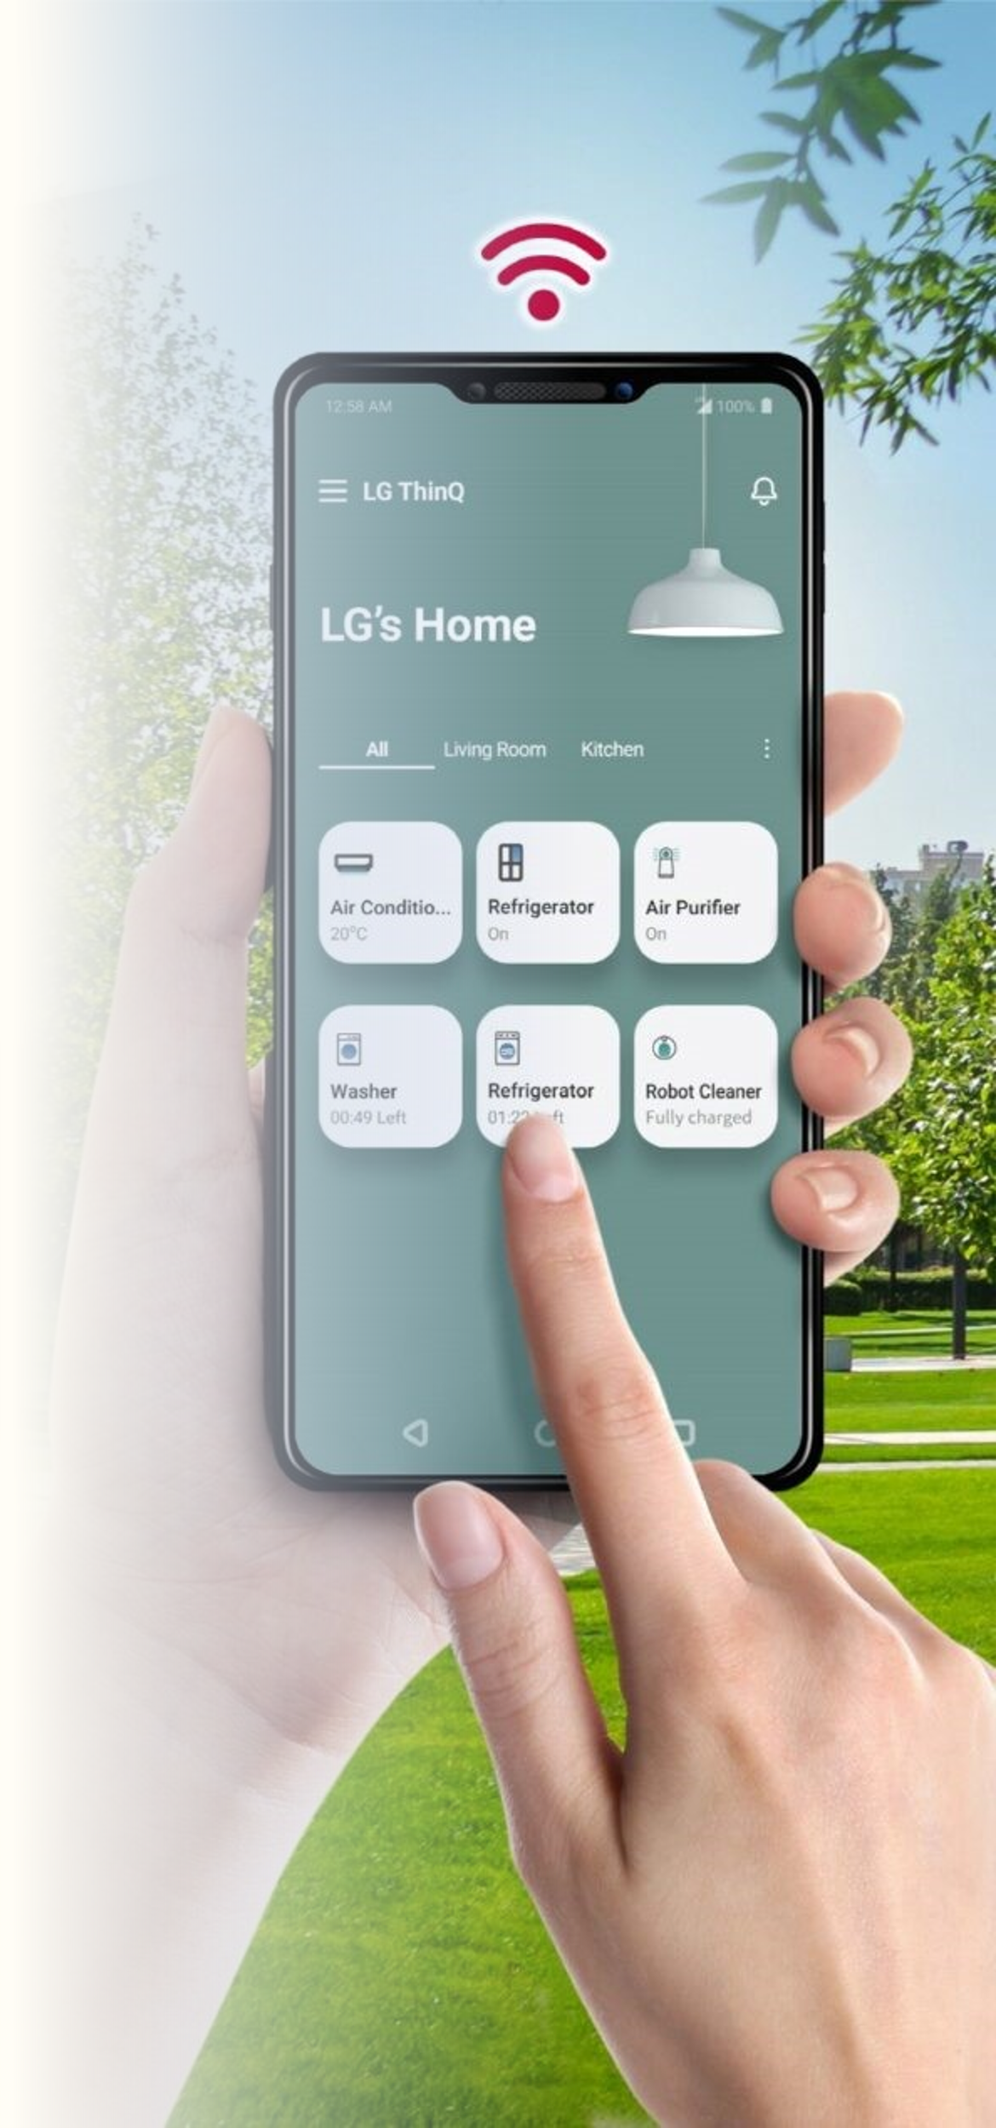
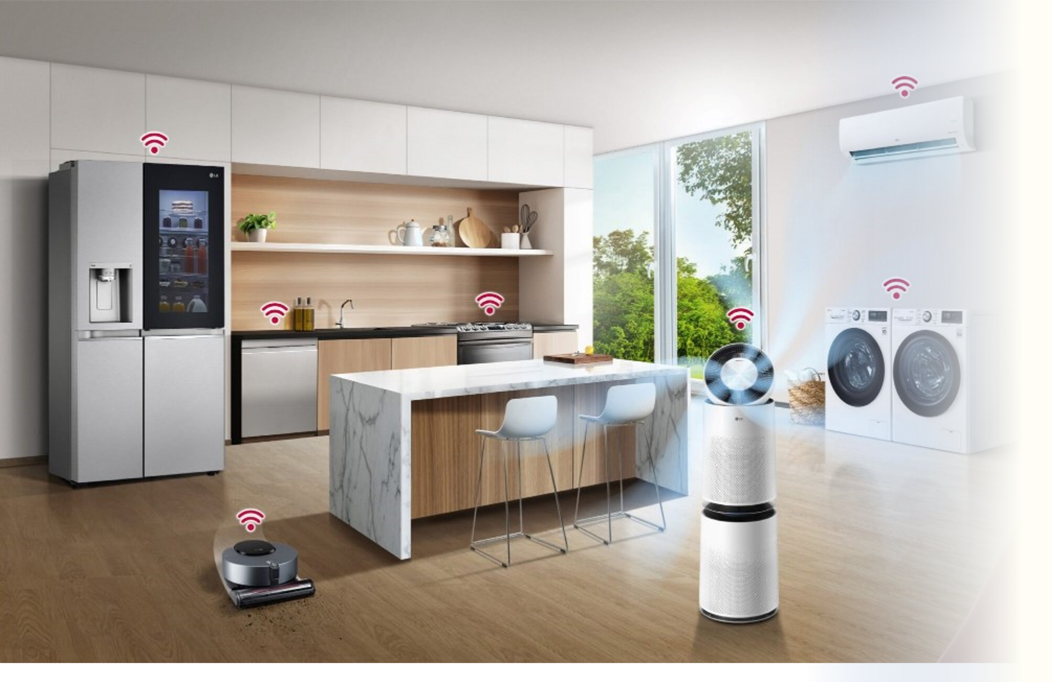
Project Title :
Title : “Smart dormitory”
We will make Smart_home_system.

Slide 3
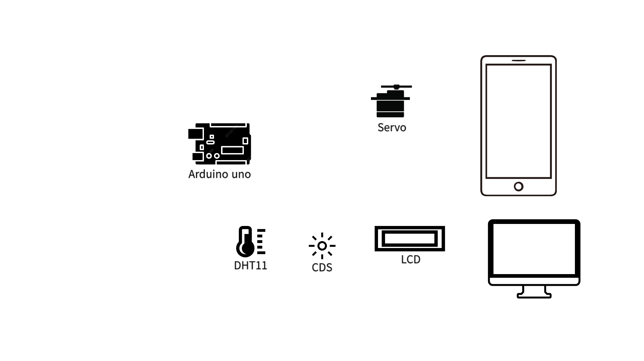

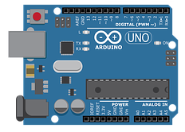

Project Goal :
1. Automated systems with conditions
(illuminance, temperature, humidity, time)
2. IoT that can communicate anywhere

Slide 4

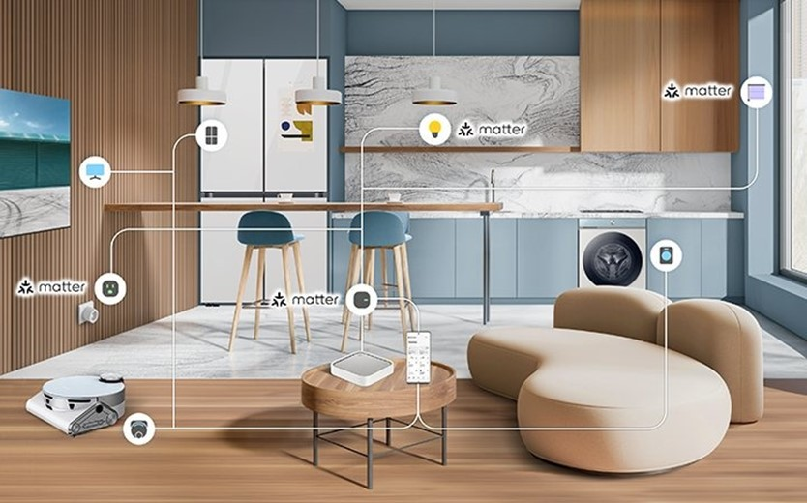
Motivation :
Samsung things

Slide 5
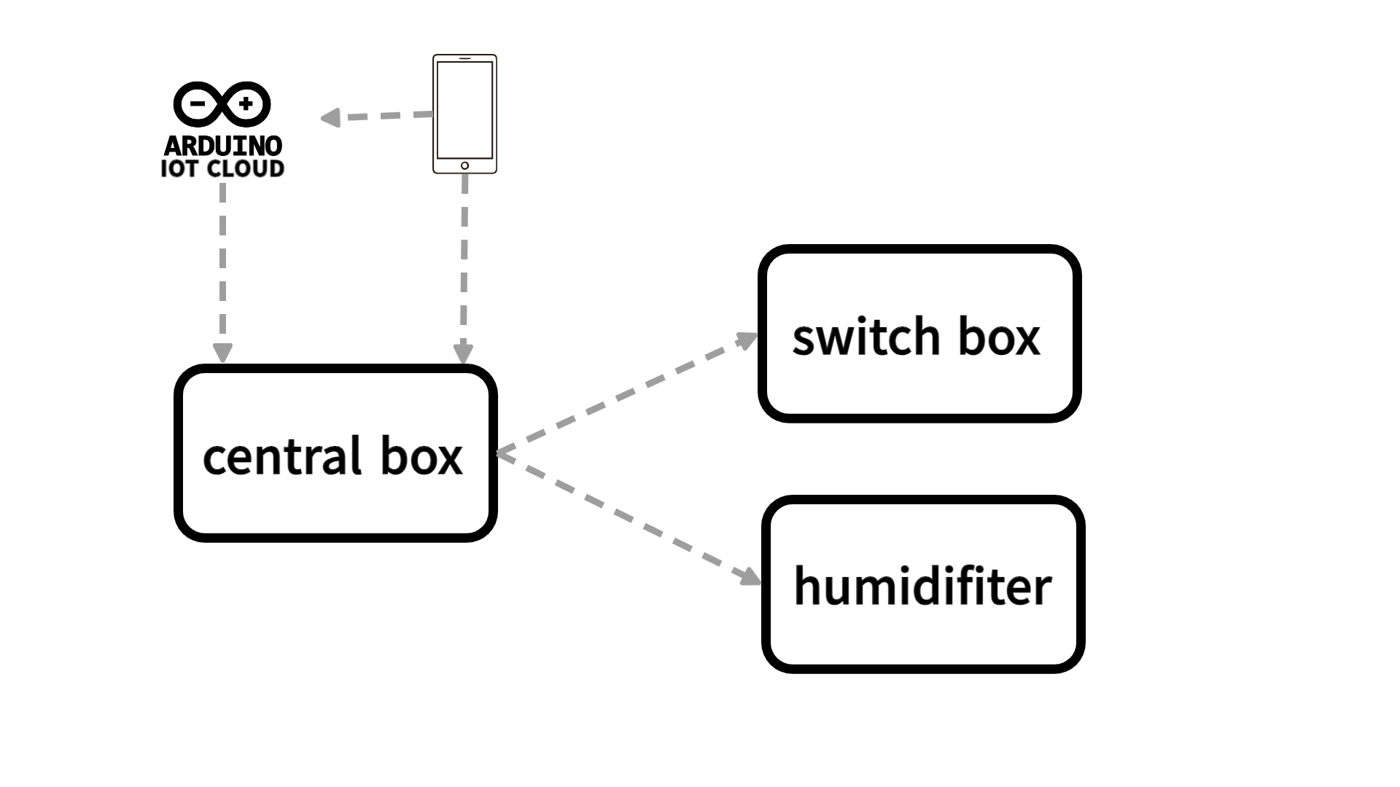
overall architecture : basic design

Slide 6
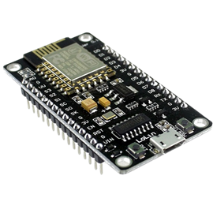
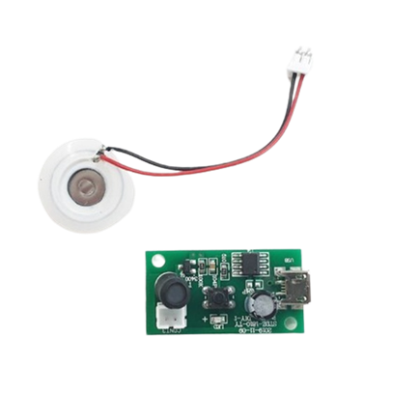
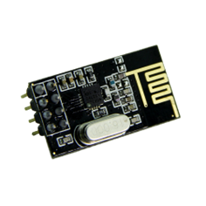
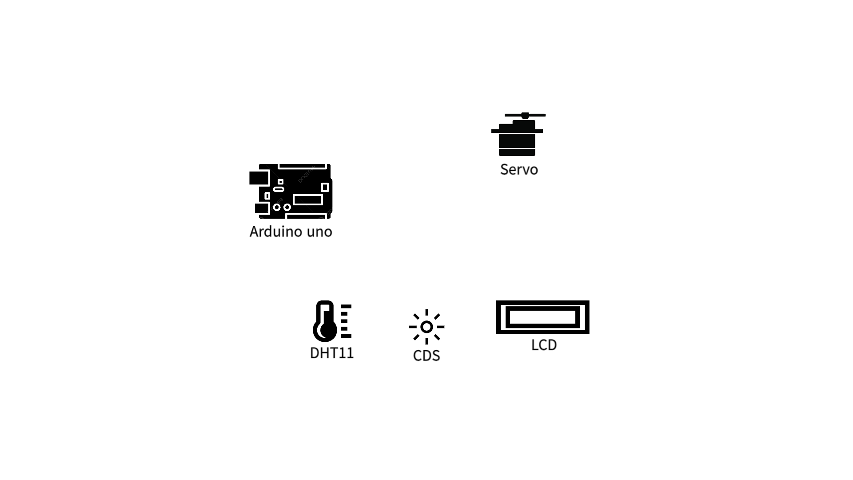
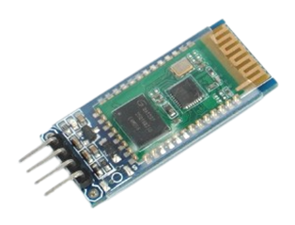
Hardware components and their role :
ESP8266 – 12E
humidifiter
To connect
Arduino_Iot_Cloud
just making vapor
nRF24L01P
For transmission
between arduinos
*3
*1
*1
HC-06 (buletooth)
To connect
phone in local space
*2
*1

Slide 7
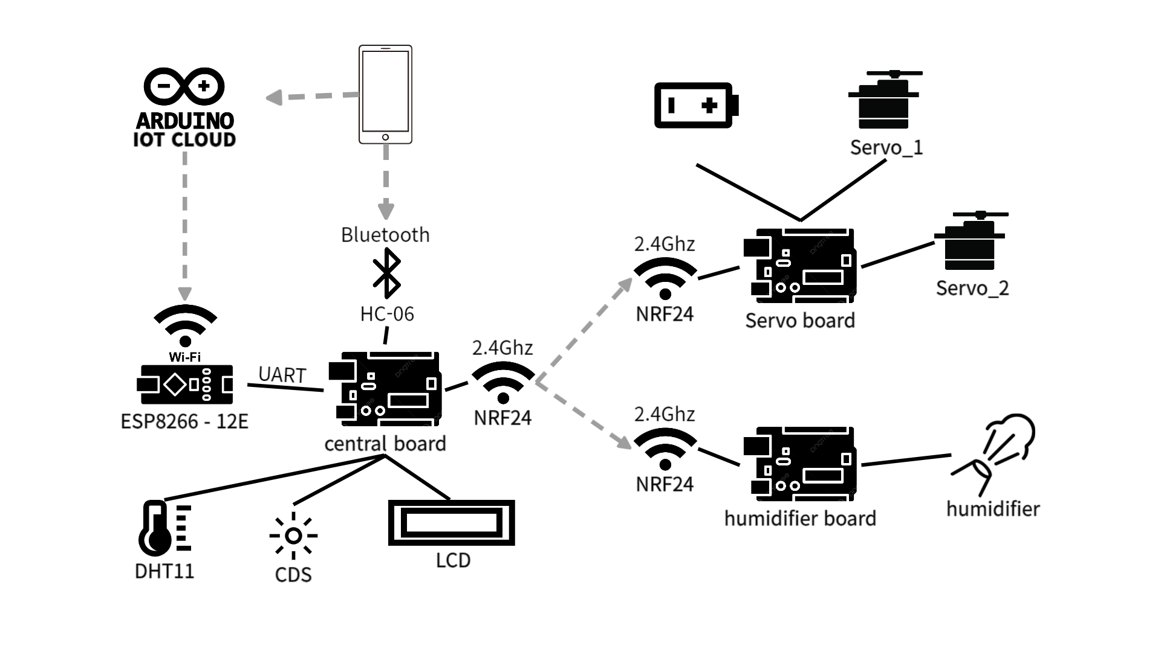
overall architecture : detailed design

Slide 8

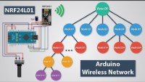
Related work
Arduino Cloud Explained
https://www.youtube.com/watch?v=uaLrmLCqGnc&t=300s
How to connect ‘Iot_cloud’ with ESP8266.
https://www.youtube.com/watch?v=3Of8Cq7mY3U
NRF24L01
https://www.youtube.com/watch?v=xb7psLhKTMA&t=208s

Slide 9


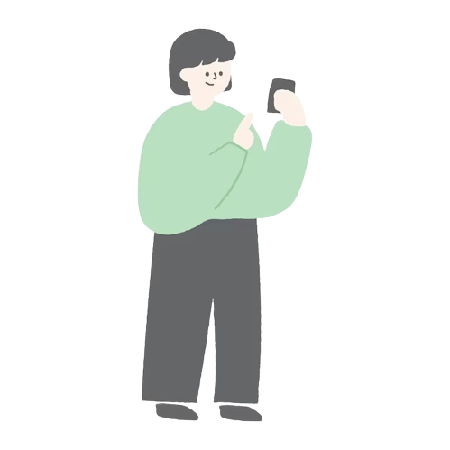
Special points of our proposed system

Slide 10
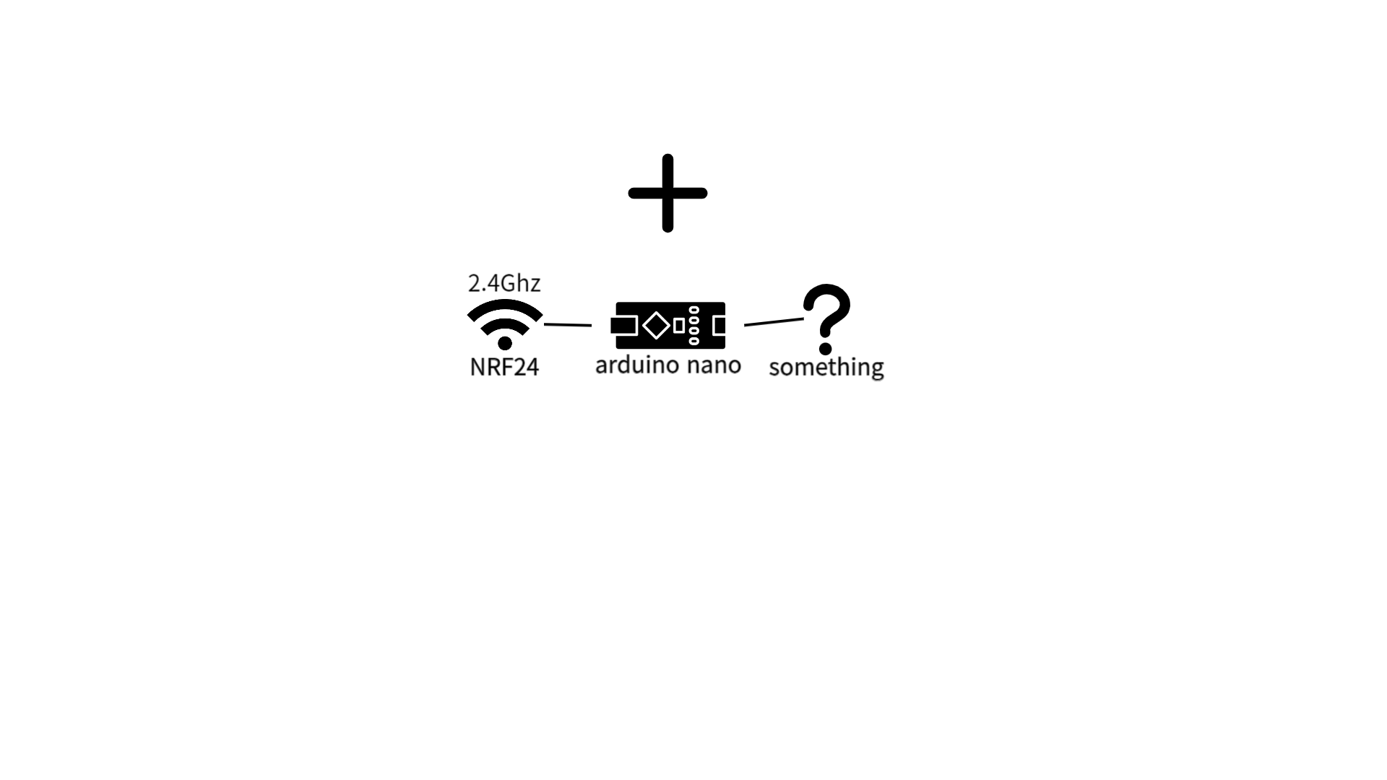
Value of our proposed system
1. Smart Care Systems in real life
2. possibility of advancement
. . .

Slide 11
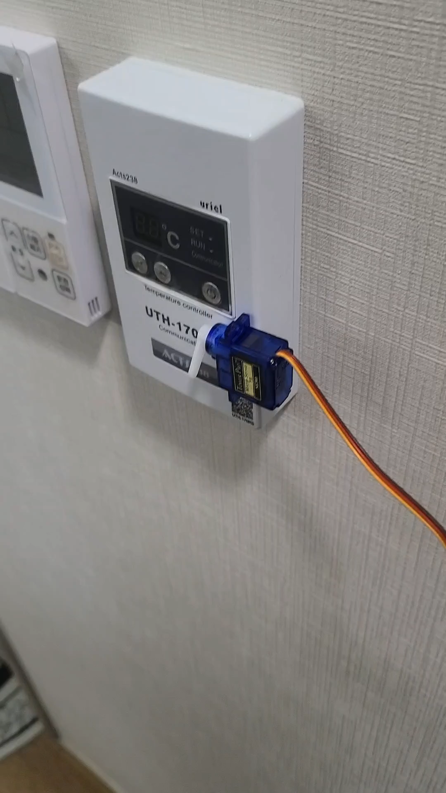
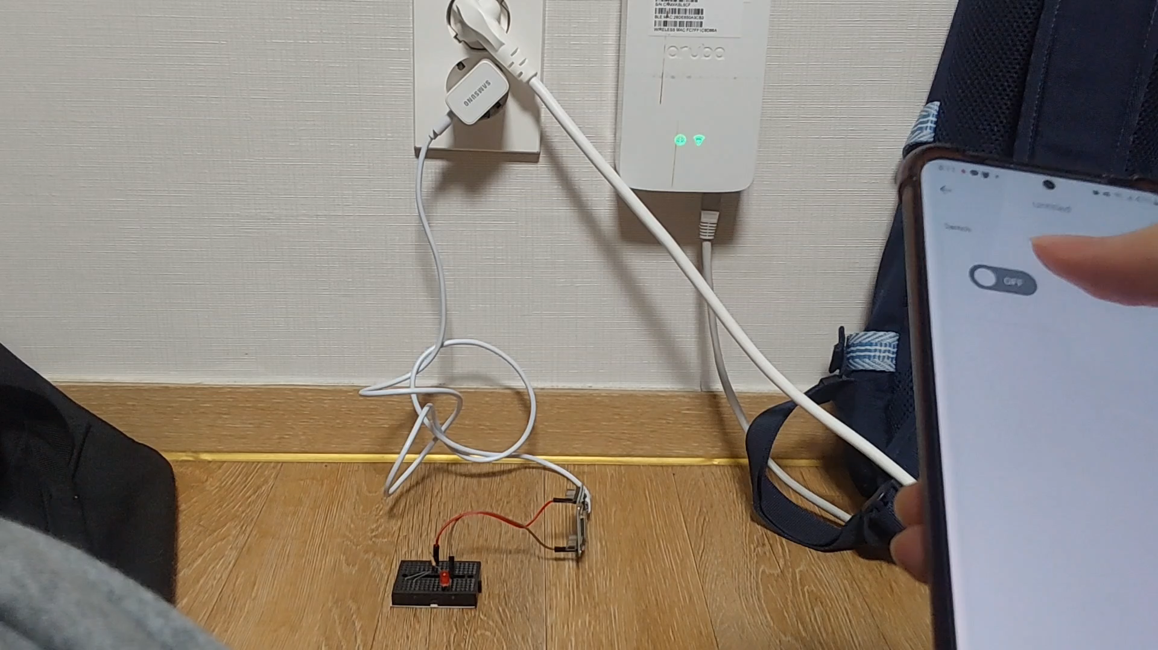
Progress
Progress of planning in detail

Slide 12
Progress
Participation of each team member
Kug HuiGeun | SW engineer
Jeong InGyo | HW engineer
Choo HoSeong | Product manager

